Slide 1
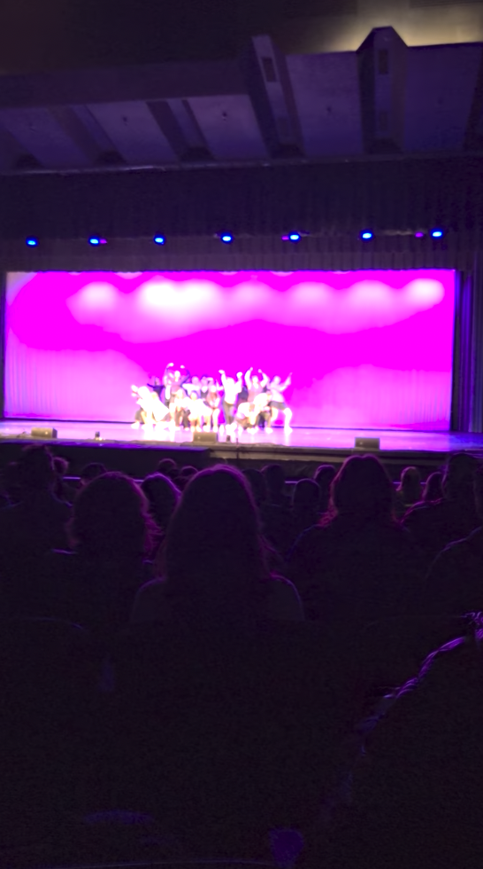

Shout-out to an amazing performance

Slide 2
Presentation schedule (right after Thanksgiving break)
Monday December 1
Group 1 (Ben, Mercer, Kyrstin): Comparative study of Enroads scenarios to Cambio
Group 6 (Winston, Ezra, Will): Climate effects of white roofs
Group 9 (Jaad): An analytical approach to Cambio
Wednesday December 3
Group 3 (Noelani, April, Amanda): Long-term emissions and the 2º warming target
Group 7 (Mika, Rose, Viviana): Fluxes of CO₂ from thawing permafrost
Group 2 (Luna and Ian): Effects of forest loss on global temperatures
Friday December 5
Group 4 (Karson, Sahaj, Alex): CO₂ released by forest fires
Group 5 (Tyler, Graham, Brendan, Santiago, Paige): Forest fire impacts
Group 8 (Sophia, Emele, Lina, and Easton): When volcanos increase albedo

Slide 3
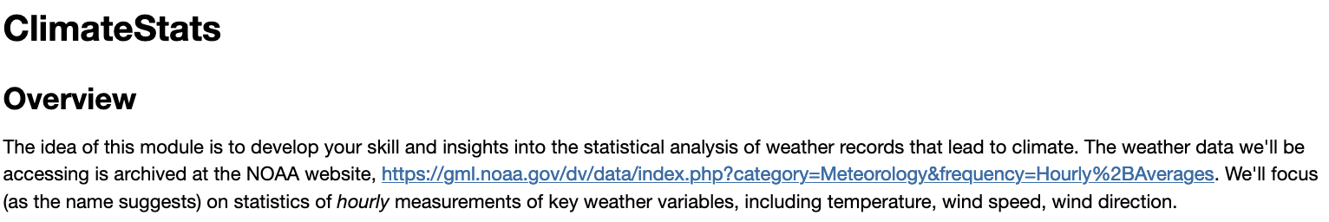
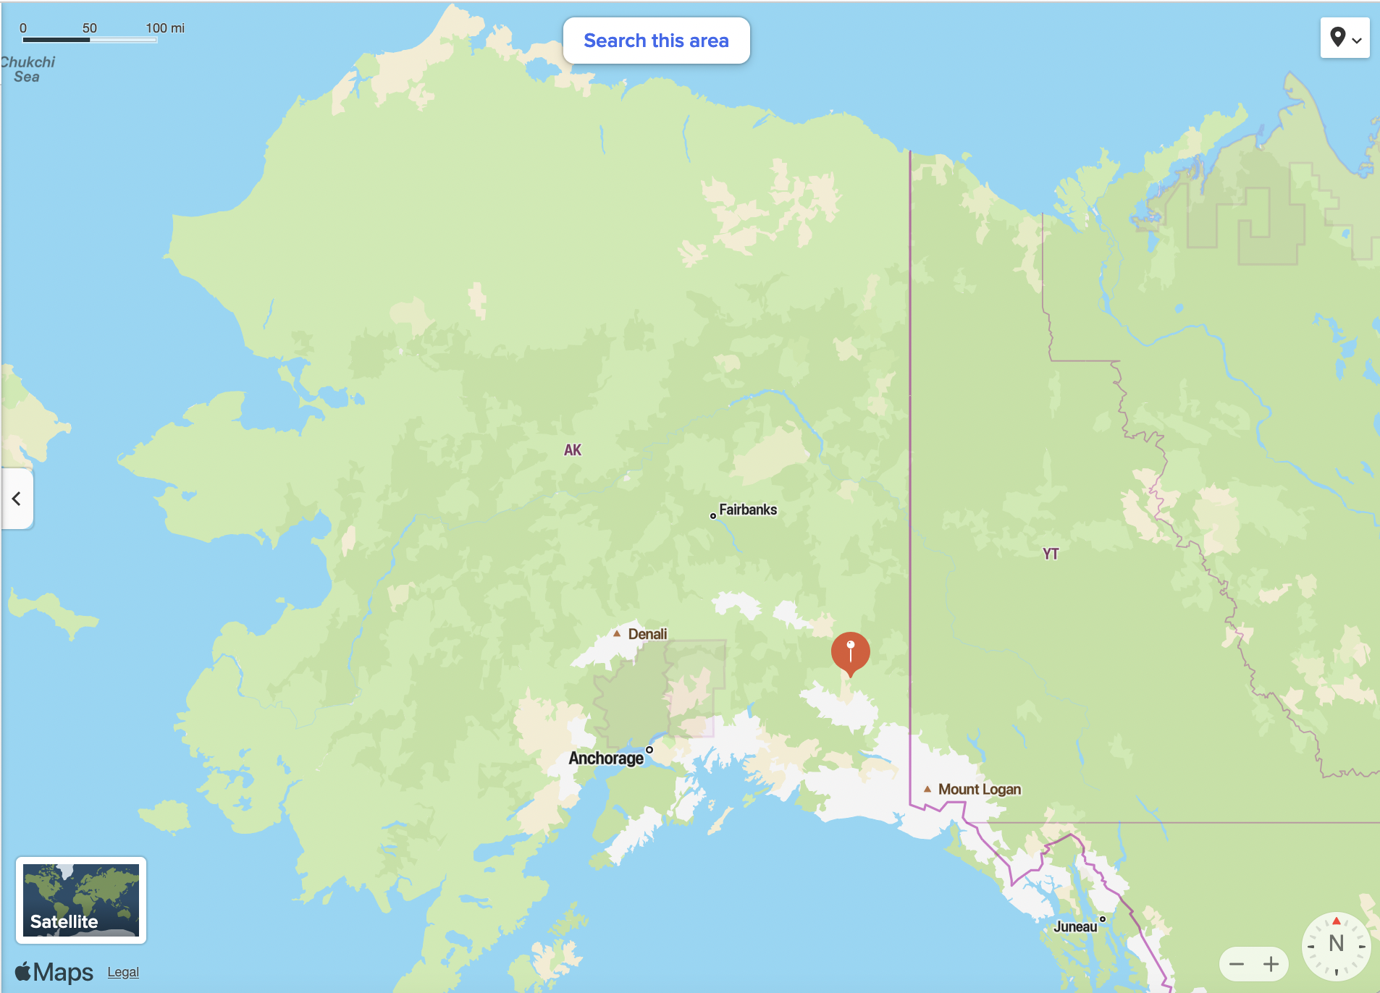
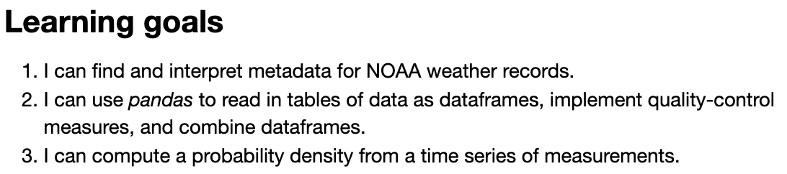
The ClimateStats CGI

